Slide 1

Tuberculosis Detection using Machine Learning
Gowtham M (412620104301)
Sanjay A (412620114301)

Slide 2
Abstract:
This project proposes a novel system for tuberculosis (TB) detection using advanced machine learning algorithms and image processing techniques. The existing methods for TB detection suffer from limitations in accuracy, time, and cost. Our system leverages chest X-ray images to automate the detection process and improve accuracy. It comprises modules for image preprocessing, feature extraction, and classification. The proposed system has the potential to enhance early diagnosis and treatment initiation, contributing to global TB control efforts.

Slide 3
Introduction:
Tuberculosis (TB) is a global health challenge that requires early detection for effective treatment. Existing TB detection methods have limitations in terms of accuracy, time, and cost. This project proposes a novel system that leverages machine learning and image processing to automate TB detection using chest X-ray images. The goal is to improve accuracy, enable timely treatment initiation, and reduce the spread of TB.

Slide 4
Existing System:
The existing methods for tuberculosis (TB) detection include traditional approaches such as sputum smear microscopy and culture-based techniques. However, these methods have limitations in terms of accuracy, time, and cost. Sputum smear microscopy has relatively low sensitivity, especially in cases with low bacterial load, while culture-based techniques are time-consuming and require specialized laboratory facilities. These limitations hinder early and efficient detection of TB, leading to delays in treatment initiation and potential disease transmission.

Slide 5
Existing System Disadvantages:
Low sensitivity
Time-consuming procedures
High costs
Dependency on skilled personnel
Invasive sampling

Slide 6
Proposed System:
The proposed system utilizes machine learning (ML) algorithms to automate TB detection using chest X-ray images. It involves image preprocessing, feature extraction, and classification. ML algorithms analyze the images to enhance accuracy and efficiency in detecting TB. The system can be seamlessly integrated into existing healthcare infrastructure, offering potential enhancements like incorporating other diagnostic modalities or enabling remote diagnosis through telemedicine platforms. The proposed system aims to revolutionize TB detection by improving accuracy, enabling earlier detection, and enhancing treatment outcomes.

Slide 7
Module Explanation (Brief):
The system consists of three modules: image preprocessing, feature extraction, and classification.
Image Preprocessing: Enhances image quality by reducing noise and improving clarity.
Feature Extraction: Extracts relevant features from preprocessed images, identifying patterns associated with TB.
Classification: Utilizes machine learning to categorize images as TB-positive or TB-negative, enabling timely identification.

Slide 8
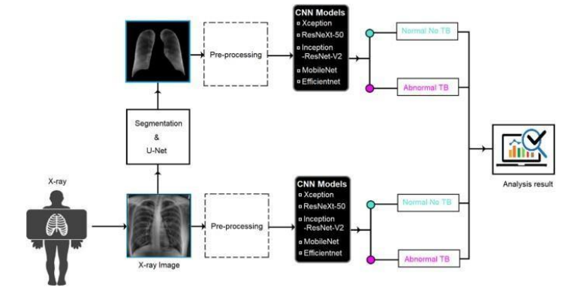
System architecture:

Slide 9
Future Enhancements (Brief):
Multi-modality integration: Integrate multiple imaging modalities for a more comprehensive assessment of TB cases.
Dynamic model refinement: Continuously update machine learning models to improve performance and adapt to changing TB patterns.
Integration of clinical data: Include additional clinical data to enhance diagnostic capabilities and personalize patient management.
Deep learning exploration: Explore deep learning techniques like CNNs and RNNs to extract intricate features and capture temporal patterns for improved TB detection.

Slide 10
Conclusion:
The proposed tuberculosis detection system utilizing machine learning and image analysis techniques holds promise for improving TB diagnosis. By automating the detection process, it enables timely identification and intervention, leading to better patient outcomes. The integration of preprocessing, feature extraction, and classification modules enhances the system's effectiveness. However, further research is needed to optimize performance, integrate additional data sources, and address limitations. This project lays the foundation for an advanced TB detection system that contributes to global efforts against tuberculosis.

